Slide 1
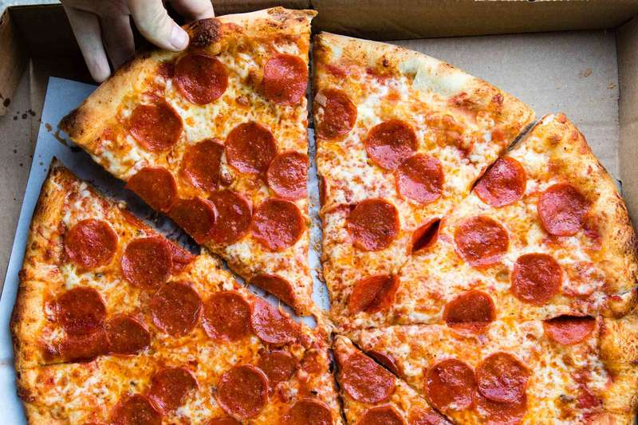
Milan, Where open a pizza shop?

Slide 2

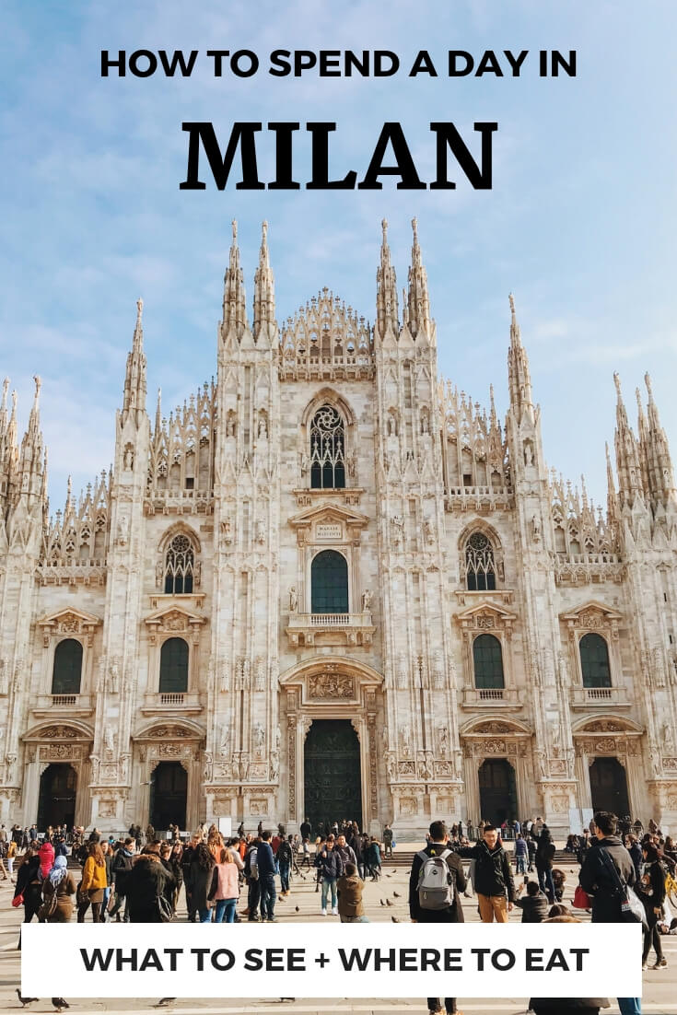
Introduction
Pizza is one of the most famous Italian dishes. And there are so many good reasons why! As can see from previous research (i.e. Turrini et.al. 2001, Di Vita et.al. 2016), pizza is an important food for Italian’s diet. And due to the famous of the pizza, almost all the tourist that came to Italy want to taste “The true Italian Pizza”.

Slide 3
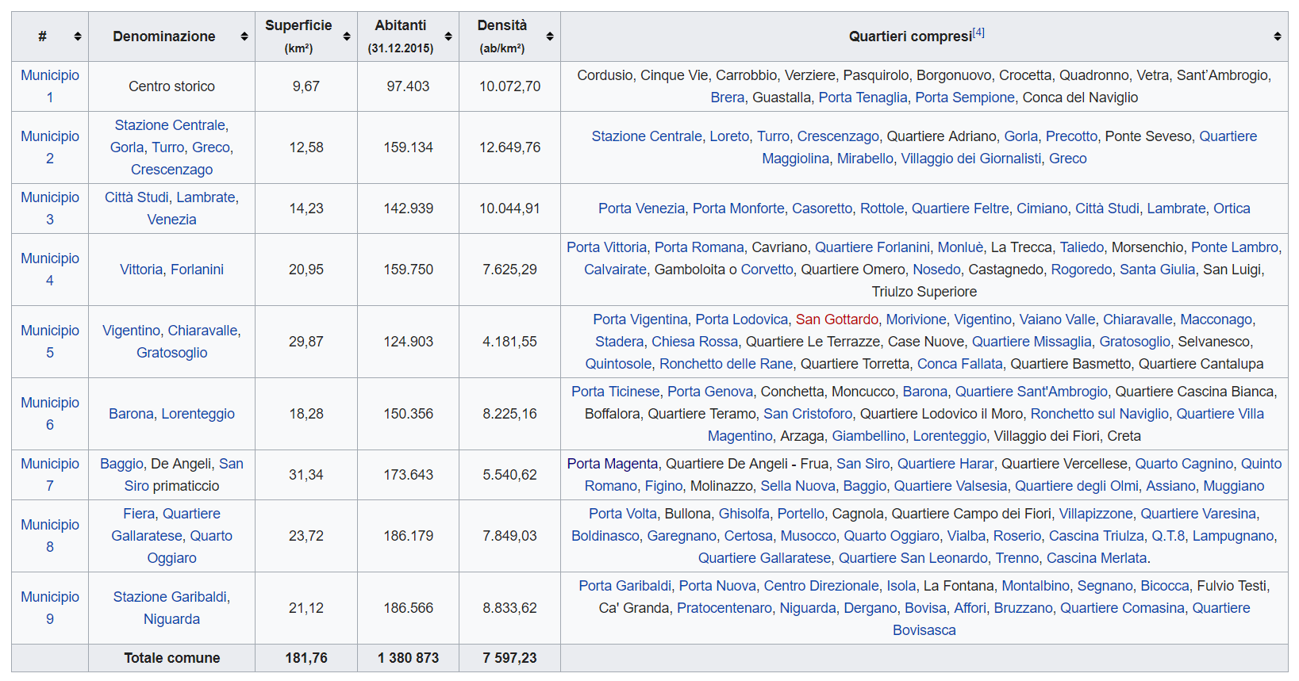
Data
Based on definition of our problem, factors that will influence our decision are:
* number of existing restaurants in the district (any type of restaurant)
* number of and distance to Pizza Shop in the district, if any
* distance of neighborhood from city center

Slide 4
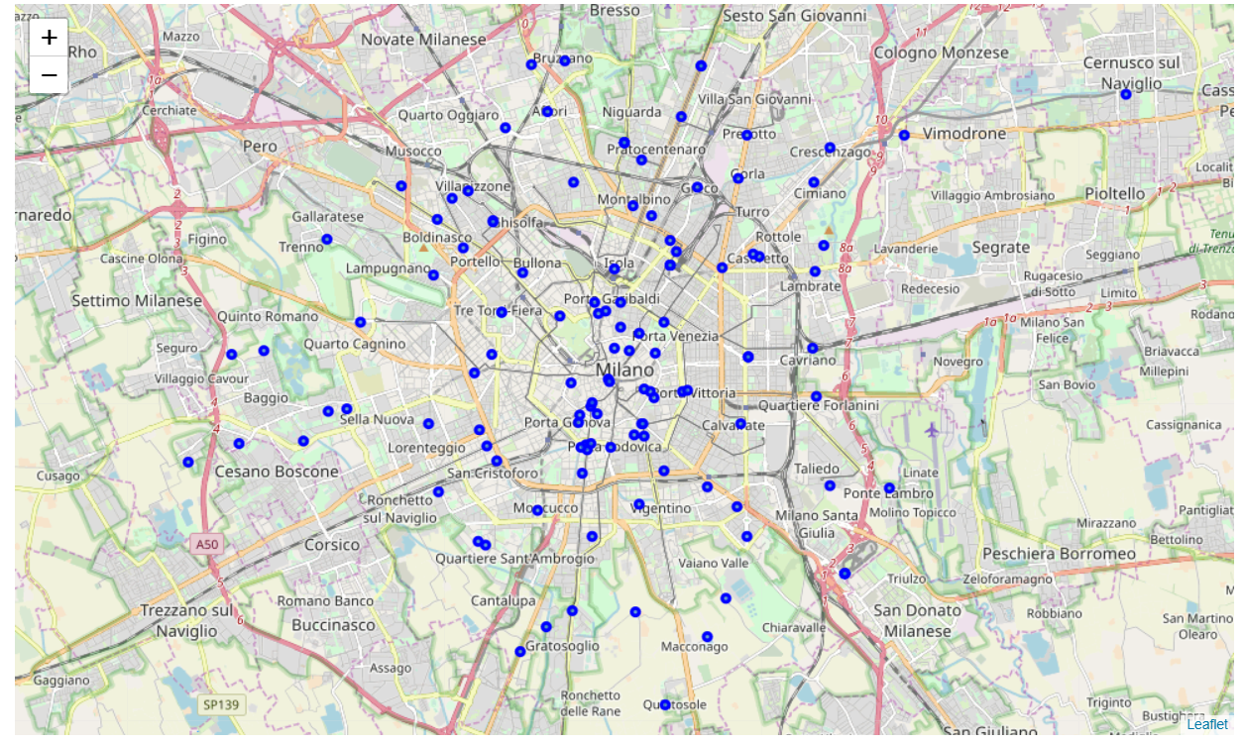
Districts

Slide 5
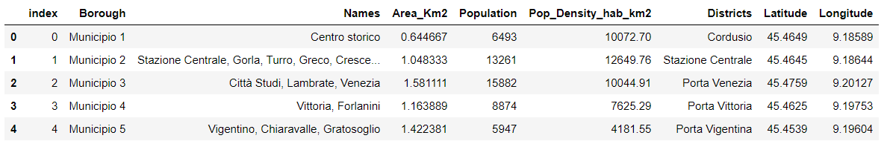
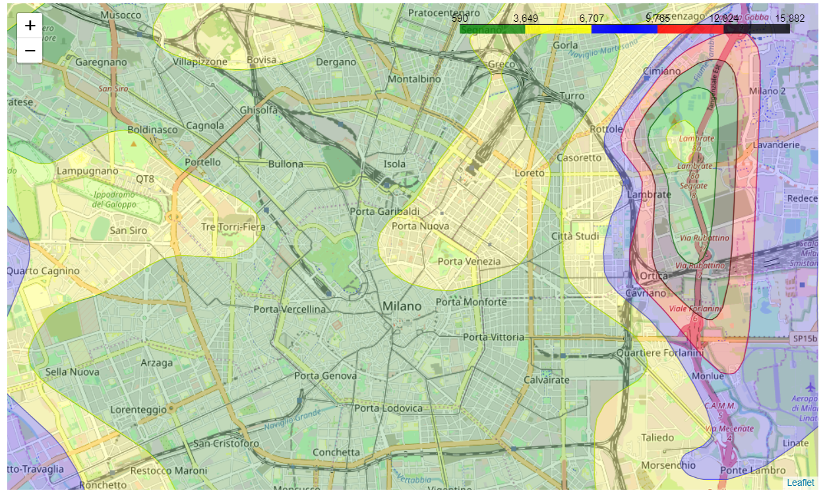
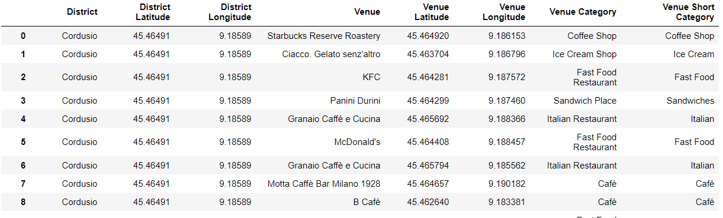
Analysis
Costumer's Density

Slide 6
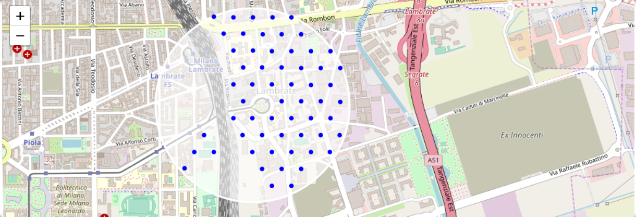
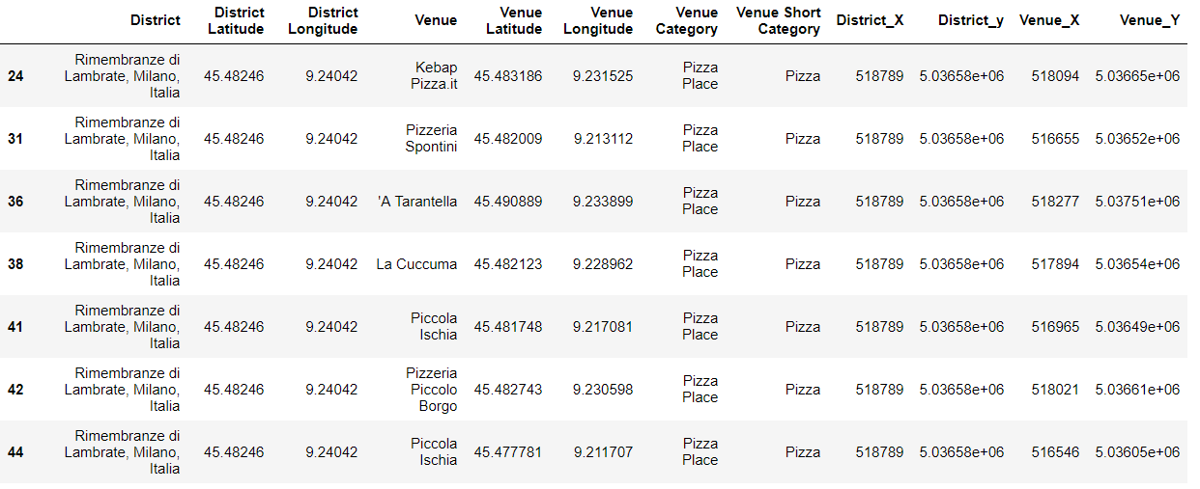
Lambrate Area
Possible locations
Restaurant’s information

Slide 7
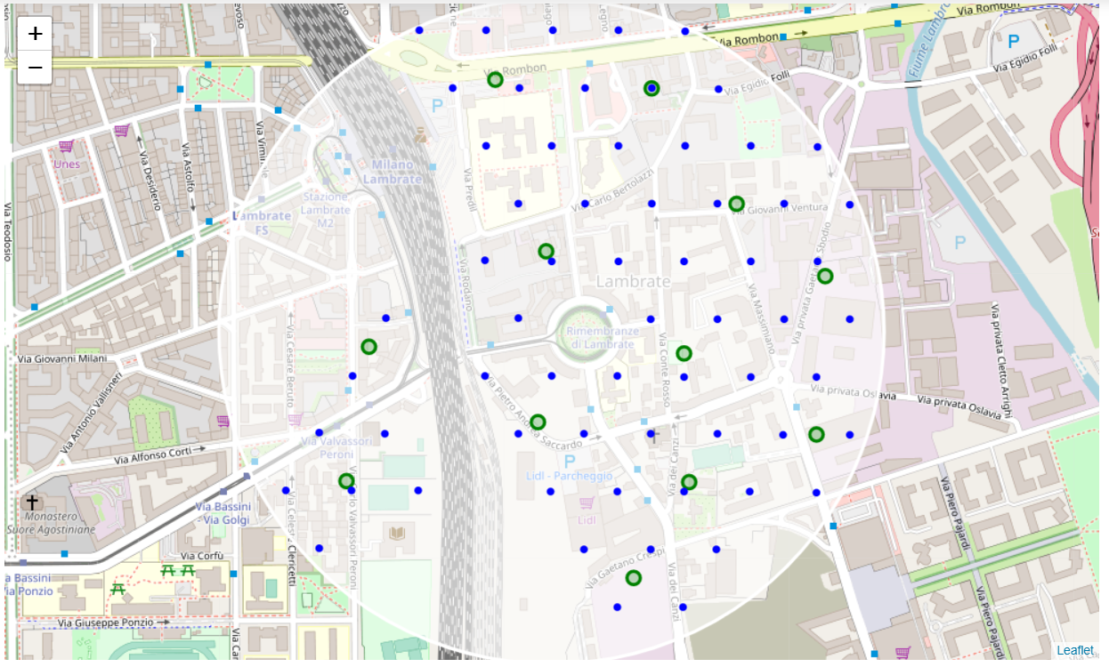
Clustering analysis
Locations from Lambrate
Finally, let get the addresses which can be presented to stakeholders.
Via Carlo Bertolazzi Milan IT => 127.1m from Rimembranze di Lambrate
Via Conte Rosso Milan IT => 167.8m from Rimembranze di Lambrate
Via privata Giovanni Ventura Milan IT => 372.2m from Rimembranze di Lambrate
Via dei Canzi Milan IT => 340.0m from Rimembranze di Lambrate
Via Carlo Valvassori Peroni Milan IT => 407.7m from Rimembranze di Lambrate
Via Riccardo Pitteri Milan IT => 382.2m from Rimembranze di Lambrate
Via Tommaso Pini Milan IT => 388.0m from Rimembranze di Lambrate
Via privata Gaetano Sbodio Milan IT => 400.0m from Rimembranze di Lambrate
Via Rombon Milan IT => 401.7m from Rimembranze di Lambrate
Via Pietro Andrea Saccardo Milan IT => 137.7m from Rimembranze di Lambrate
Piazza Enrico Bottini Milan IT => 362.5m from Rimembranze di Lambrate
Milan Milan IT => 300.9m from Rimembranze di Lambrate

Slide 8
Results and Discussion
Our analysis shows that although there is a great number of pizza shops in Milan's districts, there are pockets of low pizza shop density. We focused our attention to Lambrate area. Our attention focused to this area due to the low density of pizza shops and the high density of potential customers.
After directing our attention to this narrower area of interest we first created a dense grid of location candidates (spaced 100m apart); those locations were then filtered so that those with more than two restaurants in radius of 250m and those with a Pizza Shop closer than 500m were removed.
Those location candidates were then clustered to create zones of interest which contain greatest number of location candidates. Addresses of centers of those zones were also generated using reverse geocoding to be used as markers/starting points for more detailed local analysis based on other factors.
Result of all this is 12 zones containing largest number of potential new Pizza Shop locations based on the district population, number of and distance to existing venues - both restaurants in general and Pizza Shop particularly. This, of course, does not imply that those zones are actually optimal locations for a new Pizza Shop! Purpose of this analysis was to only provide info on areas in Milan not crowded with existing restaurants (particularly Pizza Shops) - it is entirely possible that there is a very good reason for small number of restaurants in any of those areas, reasons which would make them unsuitable for a new restaurant regardless of lack of competition in the area. Recommended zones should therefore be considered only as a starting point for more detailed analysis which could eventually result in location which has not only no nearby competition but also other factors taken into account and all other relevant conditions met.

Slide 9
Conclusion
Purpose of this project was to identify Berlin areas close to center with low number of restaurants (particularly Pizza Shops) in order to aid stakeholders in narrowing down the search for optimal location for a new Pizza Shop. First, we obtained the districts and population from Milan city, after that we get the coordinates of each district, then, by calculating restaurant density distribution from Foursquare data and correlated to the population of each district we choose Lambrate area. Then generated extensive collection of locations which satisfy some basic requirements regarding existing nearby restaurants. Clustering of those locations was then performed in order to create major zones of interest (containing greatest number of potential locations) and addresses of those zone centers were created to be used as starting points for final exploration by stakeholders.
Final decision on optimal restaurant location will be made by stakeholders based on specific characteristics of neighborhoods and locations in every recommended zone, taking into consideration additional factors like attractiveness of each location (proximityto park or water), levels of noise / proximity to major roads, real estate availability, prices, social and economic dynamics of every neighborhood etc.

